Slide 1
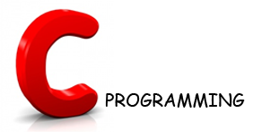

Slide 2

History of C
C language was developed by an American computer programmer Dennis Ritchie.
C evolved from two previous languages, BCPL and B was developed in 1967 by Martin Richards as a language for writing operating systems software's and compilers.
C is a hardware independent. With careful design, it is possible to write C programs that are portable to most computers.

Slide 3
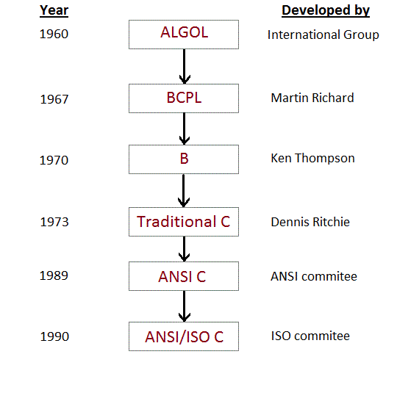

Slide 4
A Simple C program : Printing a Line of Text
/*this is my first
program in C */
#include <stdio.h>
int main()
{
printf("Welcome to C \n");
return 0;
}
Comments
Preprocessor directive
Method
Escape Character (new line )
Return value
Comments
  Text surrounded by /* and */ is ignored by computer
  Used to describe program

Slide 5
Write your first program in C
Download and install ‘Code Blocks’ ( A C editor)
Type the text appears in next slide – C ‘ Source Code’ (‘Hello World’ program)
Save the ‘Source Code’ (Use any name. By default it will be followed by .c extension)
Compile the program – To covert the source code into machine code (Build -> Compile)
If any occurs, check the ‘Source Code’, correct the errors and recompile (Build -> Compile)
Once we compile a program, the ‘Source code’ will be converted into ‘Machine Code’
To execute and view the output , Build -> Run

Slide 6
A Simple C Program:
Printing a Line of Text
#include <stdio.h>
int main()
{
printf( "Welcome to C!\n" );
}

Slide 7
Memory Concepts
Variables
  Variable names correspond to locations in the computer's memory.
  Every variable has a name, a type, a size and a value.
  Whenever a new value is placed into a variable (through scanf, for example), it replaces (and destroys) previous value
  Reading variables from memory does not change them
A visual representation
integer1
45

Slide 8
Data Types
C supports several different types of data, each of which may be represented differently with in the memory.
int | Integer quantity
char | Single character
float | Floating-point number
double | Double-precision floating-point number

Slide 9
Data Type | printf conversion specification | scanf conversion specification
int | %d | %d
short | %hd | %hd
double | %f | %lf
float | %f | %f
char | %c | %c
unsigned int | %u | %u

